Slide 1


DATATRICKS
How pollution and climate change impact on Malaysian Fisheries
Faculty of Computing, Universiti Teknologi Malaysia

Slide 2



DataTricks
Dr. Mohamad Shukor Bin Talib
Dr. Yusliza Binti Yusoff
Dr. Haslina Hashim
Dr. Nor Erne Nazira Bazin
Dr. Noor Hidayah Zakaria
Affiliation:
Faculty of Computing,
Universiti Teknologi Malaysia

Slide 3




SDG area
SDG 2
Zero Hunger
SDG 13
Climate action
SDG 14
Life below water

Slide 4
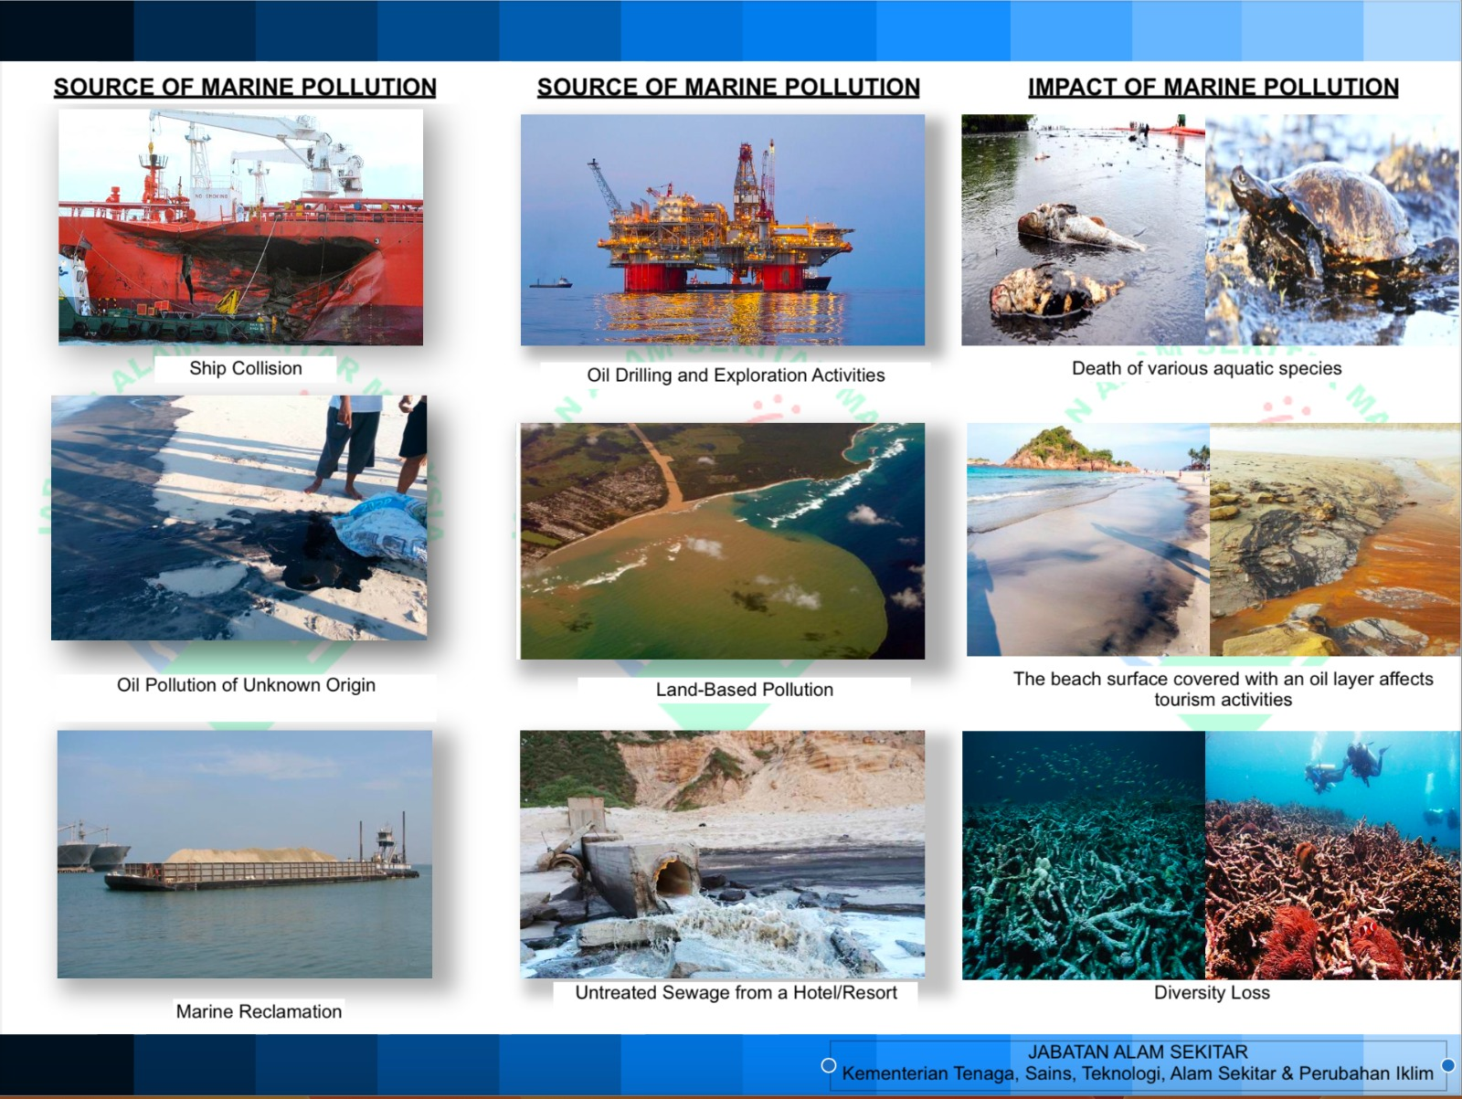
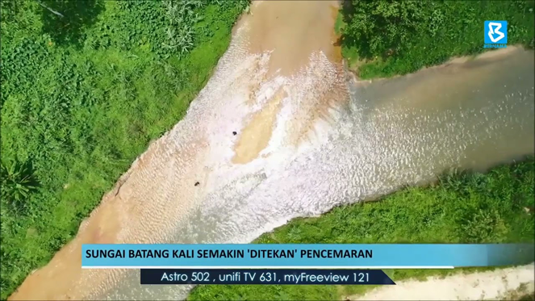
POLLUTIONS
INTRODUCTION
Introduction of harmful substances into the environment, while climate change pertains to long-term shifts in weather patterns and temperatures. Both factors have detrimental effects on Malaysian fisheries, which are crucial for food security and the national economy.

Slide 5

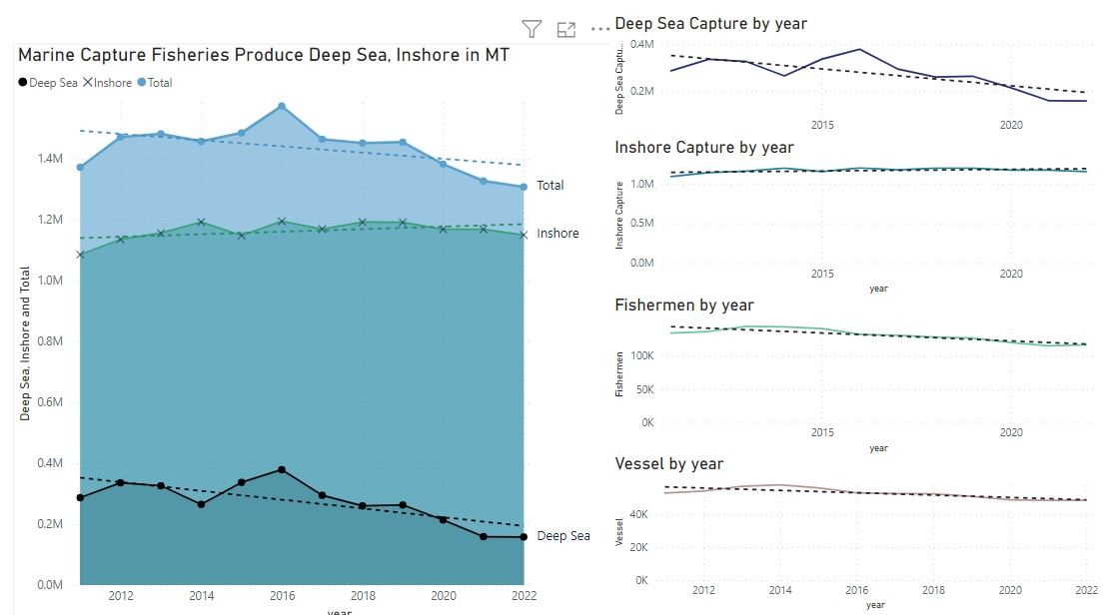
FISHERIES ISSUE IN MALAYSIA
a)
In between 2015-2020, the data shows:
significant declining trend in deep sea capture in Malaysia
Reducing numbers in Malaysian fisherman
Reducing numbers in fisheries vessels
Which contributes to increasingly impacting the food source and ecological balance of marine life in Malaysia.
b)
c)

Slide 6


Sea Pollution in Malaysia
Malaysia's geography features numerous rivers that are interconnected with the sea, and this connectivity plays a significant role in inshore pollution.
RIVER SYSTEMS AND SEA CONNECTIVITY
INSHORE POLLUTION PATHWAYS
•Pollution from urban and industrial sources often finds its way into the river systems due to runoff and direct discharge.
•These pollutants are then carried downstream by the rivers, eventually reaching the sea.
•Inshore pollution occurs when these contaminants are discharged into coastal and nearshore waters, affecting the marine ecosystem.
•Malaysia is blessed with a dense network of rivers and waterways, many of which originate in the highlands and flow downstream towards the coast.
•These rivers serve as essential drainage systems for both urban and rural areas, collecting rainwater and transporting it towards the sea.
•As these rivers meander through the landscape, they often pass through or near urban centers and industrial zones.
AGRICULTURE AND DEFORESTATION
URBANIZATION AND INDUSTRIALIZATION
•Agriculture is a vital part of Malaysia's economy, and the use of pesticides, fertilizers, and herbicides can lead to agricultural runoff that enters rivers.
•Deforestation in the country's interior regions can increase soil erosion, leading to sediment-laden runoff entering the rivers.
•These factors contribute to inshore pollution as the rivers transport agricultural chemicals and sediments to the coastal areas.
•Over the years, Malaysia has witnessed rapid urbanization and industrialization, especially along the coast and riverbanks.
•Urban areas generate domestic sewage, while industrial zones produce pollutants such as chemicals, heavy metals, and effluents.
•The concentration of people and industries near rivers results in a higher likelihood of pollution.

Slide 7
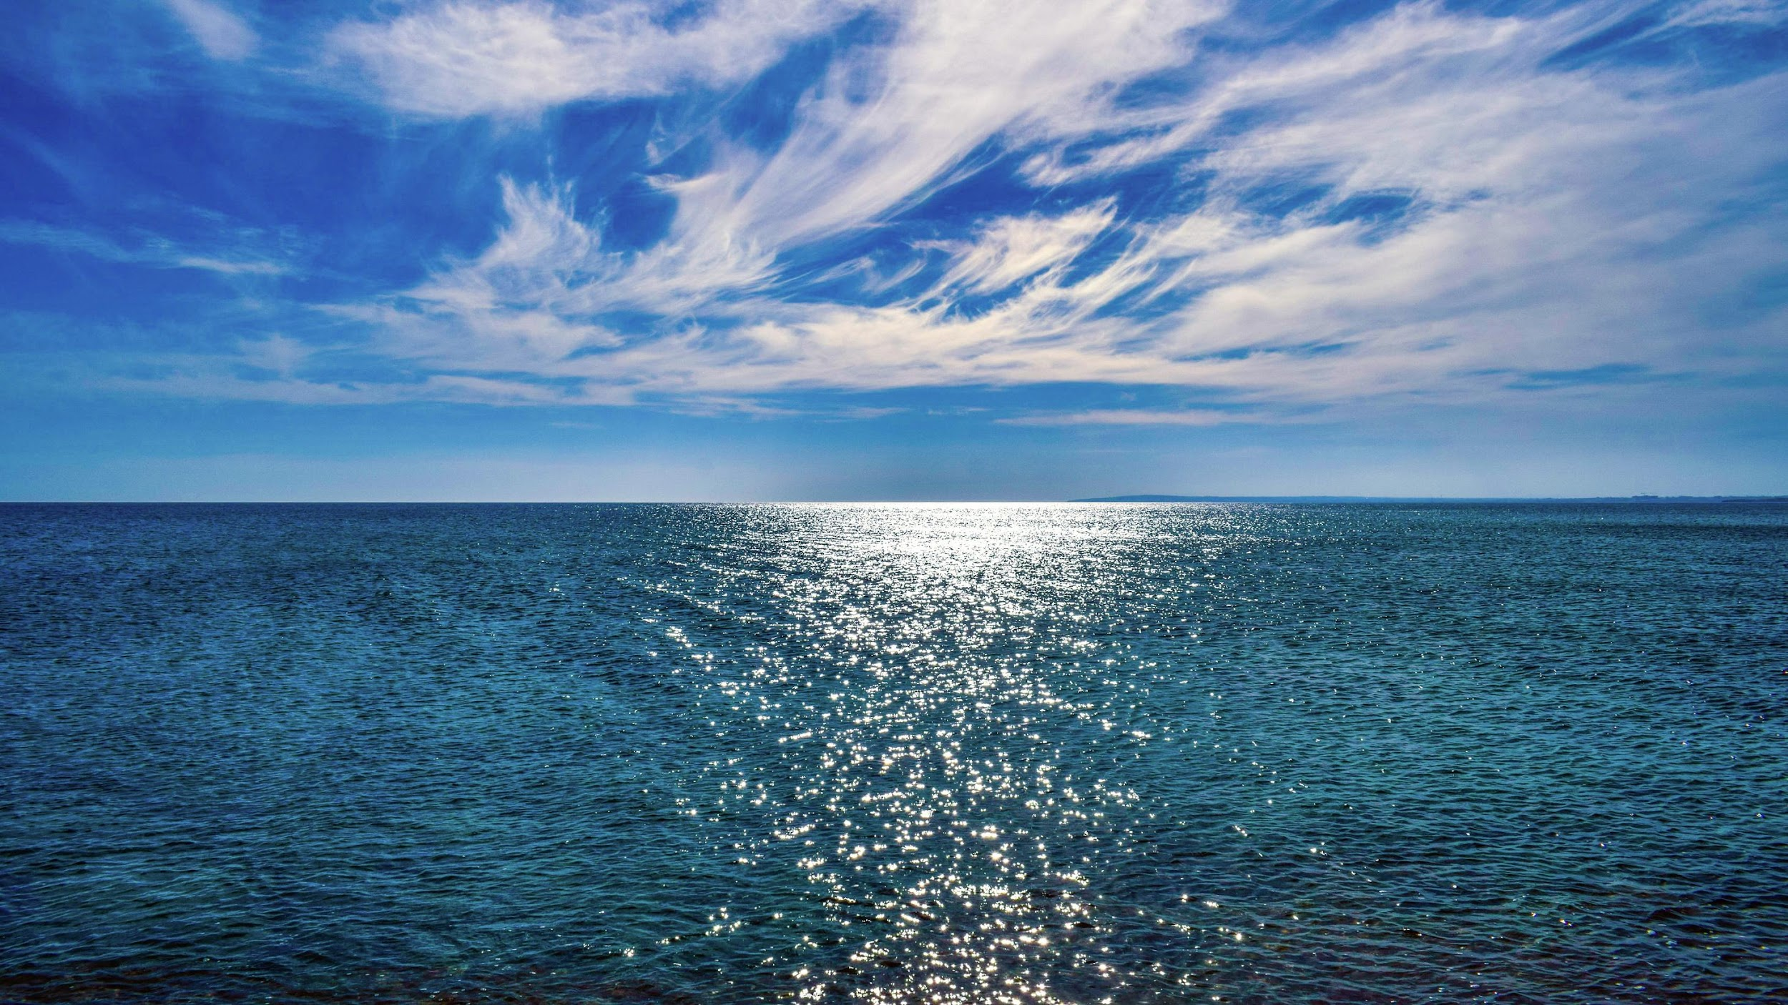
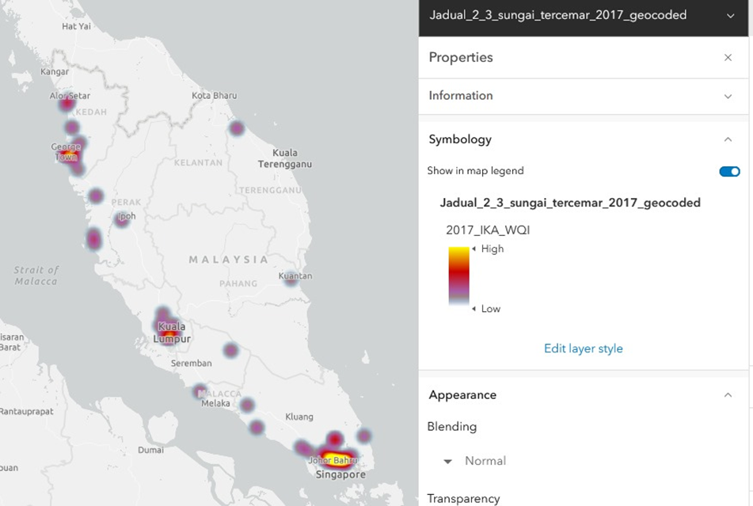
Sea pollution (inshore) due to river pollution that connected to the sea. River pollution contributes to sea pollution, leading to a decrease in marine catches.
Red zone areas indicate polluted region in West Malaysia.

Slide 8
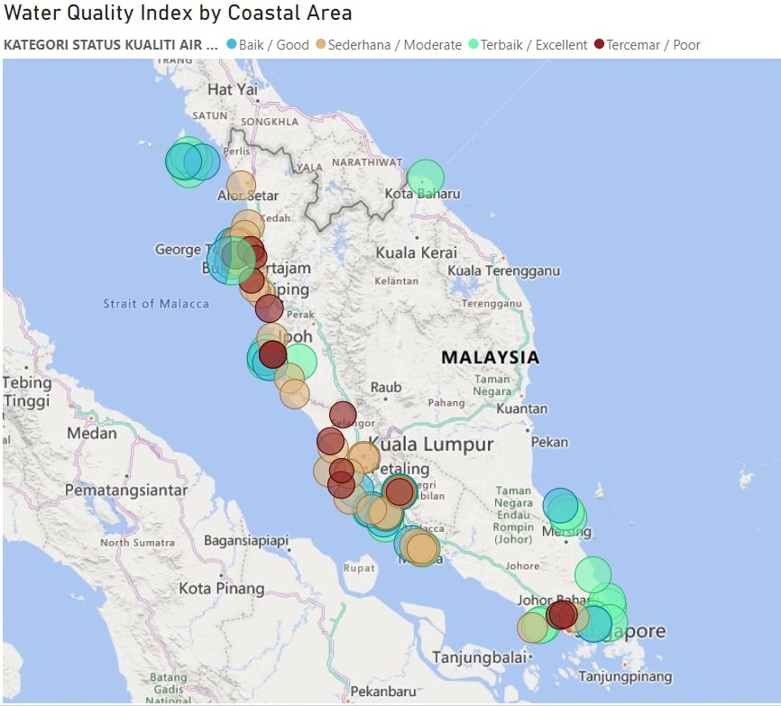
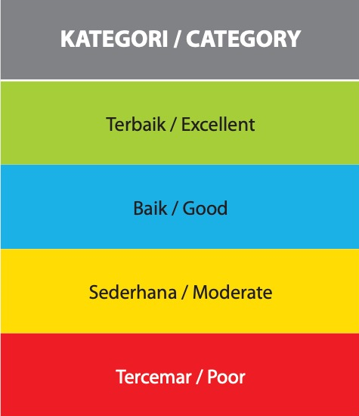
Water quality in Malaysia is a major concern due to pollution.
According to the Department of Environment, approximately 20% of rivers in Malaysia were classified as slightly polluted, while 75% were categorized as clean.
In the same year, nearly 5% of rivers in the country were considered polluted. The National Water Quality Standards set by the Department of Environment provide guidelines for the quality of water in Malaysia.

Slide 9

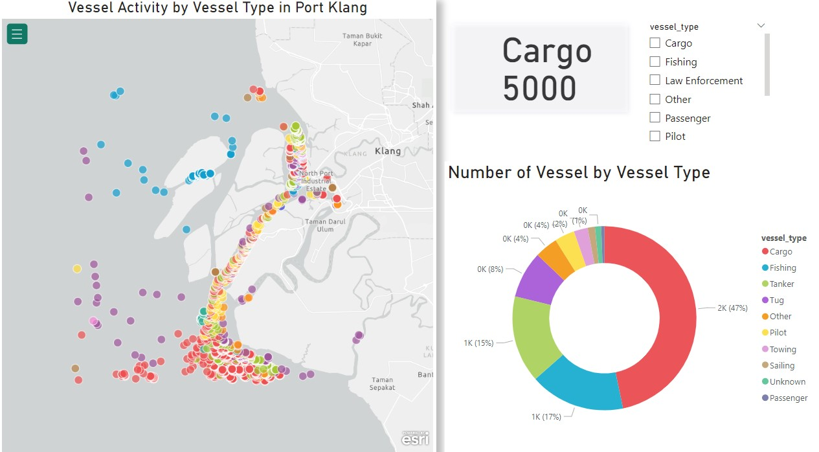
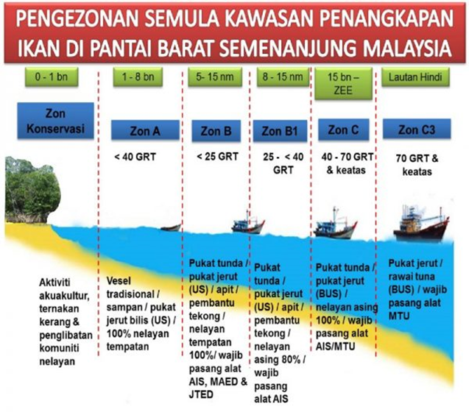
Maritime shipping such as recreational vessels, fishing boats and scientific research vessels can also be a source of marine pollution if they fail to properly store and dispose of the litter on board. It is also derived from offshore farming, offshore oil and gas platform production operations.
Port Klang’s vessel traffic management system (VTMS) allows the monitoring of vessels in real time to enable safe and efficient traffic management in port limit. It also provides information on vessels transiting the port such as cargo onboard, last and next port of call and the vessel’s particulars

Slide 10
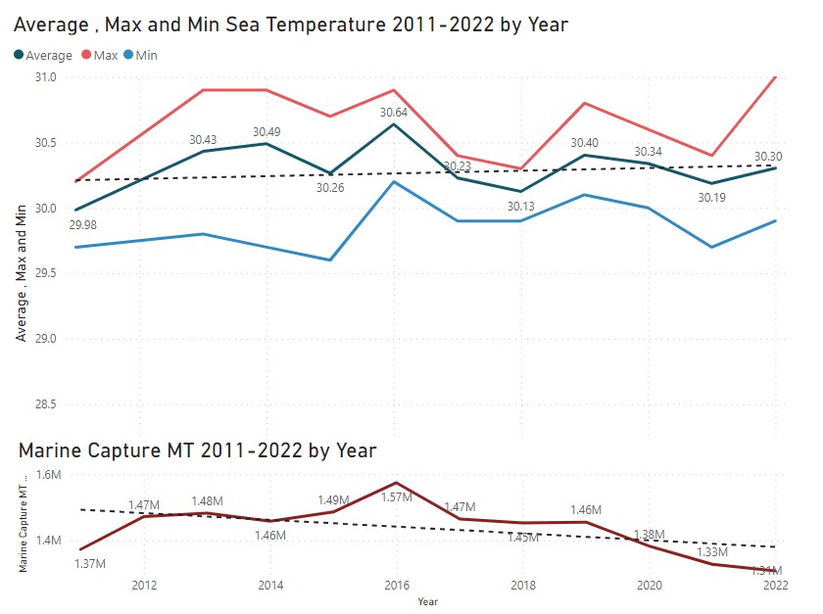
Issues of
climate change
a)
The average Malaysia sea surface temperature has been increasing since 2020 (a), with the past three years being the warmest on record.
Hence, resulting in significant decreasing in marine capture (b).
b)

Slide 11

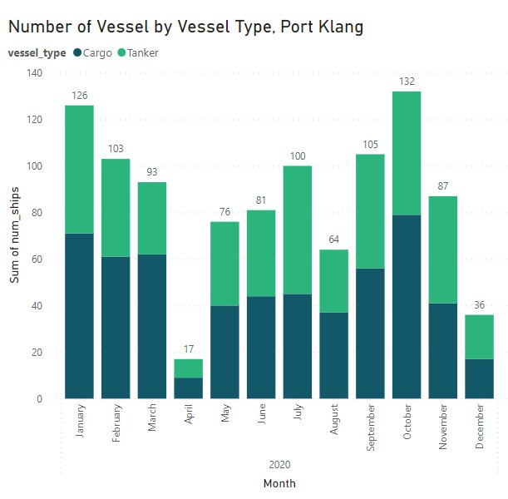
AIS data to track shipping activities
The chart shows that number of vessel type in 2020 using AIS data. Main vessel type in Port Klang, Malaysia are cargo and tanker. The numbers in vessel activities show the highest number in October, January, and September 2020.

Slide 12

Conclusion
Water pollution has a significant impact to biodiversity loss which threat food security in the long run. It is vital to enforce stringent regulations, promote sustainable agricultural practices, enhance wastewater treatment, encourage eco-friendly industries, educate communities, protect ecosystems, foster international cooperation, and invest in research and innovation for more effective pollution control

Slide 13
Data Source
AIS DATA (https://comtradeplus.un.org/)
Malaysia Fisheries Report (European Inland Fisheries Advisory Commission (EIFAC))
Department of Environment Ministry Of Natural Resources, Environment and Climate Change (https://www.doe.gov.my/)
Malaysia River Quality Index (European Inland Fisheries Advisory Commission (EIFAC))
SEA TEMPERATURE INFO(https://seatemperature.info/november/port-klang-water-temperature.html)
footer

